Slide 1

Personal Loan Prediction
Product Name: Personal Loan Prediction on cross-selling Platform.
Submission By: Narendra Venkatesan

Slide 2
Product Canvas
Personal Loan Prediction based on cross-selling platform and Factors influencing the same.
Customer Segment/Lead Generation
Customer Relationship/Operations
Credit
Value Propositions/Sales
Final Disbursal
Policies
Document. Management System/Operations
FDS/Fraud Detection
Credit Score

Slide 3
Summary of Improvements
Influence of Digital Transformation on deciding of loan predictions.
Focus on customers, clients and organizations.
Data Used from Machine Learning analysis or the questions related to analytics needs to be addressed before decision has been made.

Slide 4
Summary of Improvements Contd..
Data Collected from bank needs to be analyzed which includes machine learning techniques such as Exploratory Data Analysis.
Data needs to be organized in order to be processed in accordance with the data protection laws. This can vary from one country to the another.
Data visualization needs to be done and data needs to be prepared for train the model.
Data or the model needs to be evaluated as per the requirements.

Slide 5
What are the new things that you haven’t thought about, but others have helped you in this journey?
At first, I did not think of Prediction of customer analytics which I came to know through my friends and colleagues.
There were lot of new learnings that I learnt while building the above product canvas such as considering the factors that would influence the decision of taking a personal loan.
The most important thing that I considered were the different customer segments who would prefer taking personal loan.

Slide 6
What are the key challenges that you faced in developing Product Canvas?
Key Challenges faced in developing Product Canvas:
Factors to be considered for the eligibility of clients.
The most important challenge I faced was to determine the cut off limit for the credit score.
To determine client relationship with bank and to see if customer had previously taken loan or not.

Slide 7
Develop analytical questions that lead to addressing end state of your product idea
Analytical questions which include the following:
What kind of data needs to be considered including the individual and organizational level of data.
If that data needs to be split into train and test data
What kind of interest rates needs to be charged
The data gathered needs to be processed through Machine learning which includes EDA, evaluation metrics, and model building.

Slide 8
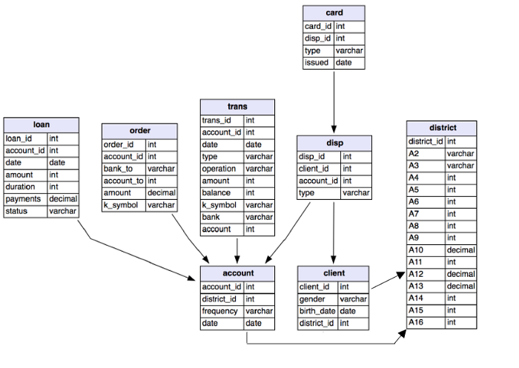
Third Normal Form
Notes:
Data has been taken from “https://medium.com/@pankajgurbani01/machine-learning-model-to-predict-loan-default-9c33f87e1a38”

Slide 9
Entity Relationship Diagram
Client name
Client Street
Loan Number
Amount
Client id
Client city
Borrower
CUSTOMER
loan

Slide 10
Challenges faced while developing conceptual model / ER Diagram
A clear context on what kind of customers to focus on while predicting the eligibility of giving clients loan.
Factors depending whether we can consider a particular client.
External factors such as verifications , multiple background checks needs to be carried out before we process application.
The key issue was predicting in what kind of clients to choose from.

Slide 11
How can we potentially answer these questions? Data sourcing Strategy
The data from the bank which indicates previous records of customer.
Organizations provide de-identified data for analyzing and modeling purpose.
For data that needs to be analyzed we will have to consider two files train and test. Also, one file which will show the whole data represented.

Slide 12
Map these questions against Entities to validate if we will be able to answer the questions hypothetically or do, we need to tap into other data sources
At this stage we would need to answer these hypothetically as we do not have the original dataset available with us.
Also, the organizations won't be able to share such data as it might lead to data breach.
Potentially we might need to tap into other data sources to fetch hypothetical data and process it through multiple iterations.

Slide 13
References
https://www.kaggle.com/rajansharma780/personal-loan-prediction
https://medium.com/analytics-vidhya/machine-learning-model-to-predict-prospective-customers-for-personal-loan-e4f7a60a2739
https://www.productplan.com/learn/business-model-canvas/
https://mint.intuit.com/
https://www.kaggle.com/pritech/bank-personal-loan-modelling

